Slide 1
Knock Detection Reference Code Specification
Steve.Han
28.07.2015

Slide 2
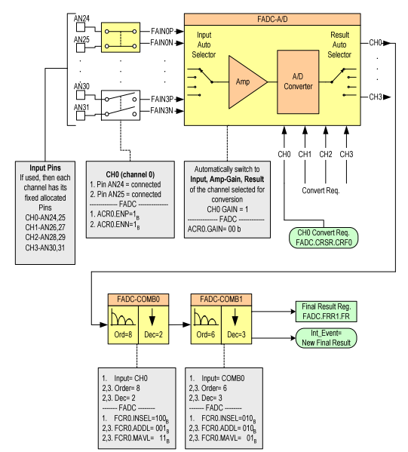
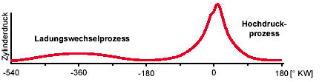
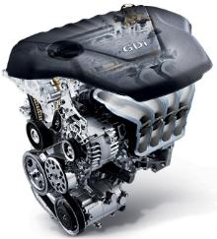
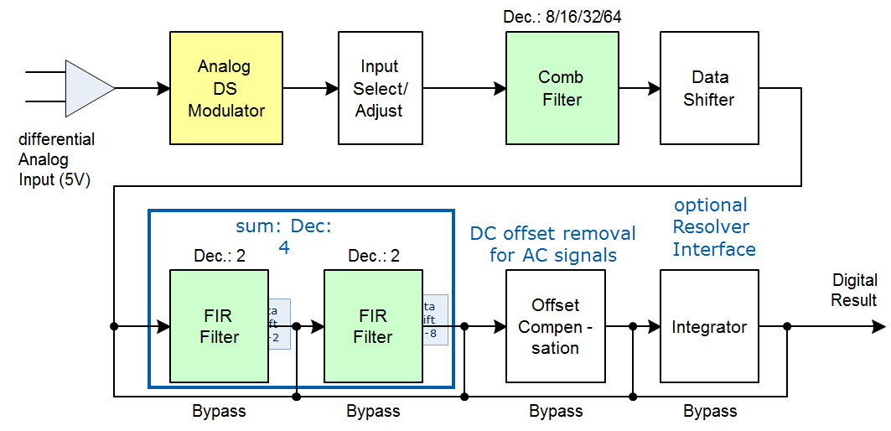
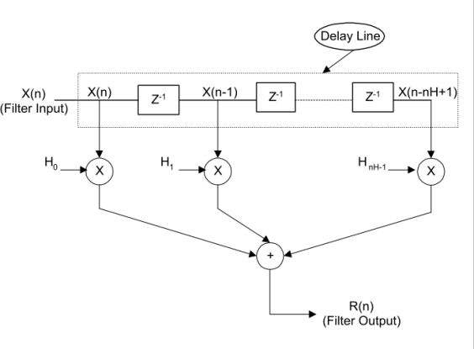
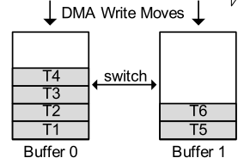

SW concept
Conventional
Anti aliasing FIR
DMA
Knock detection FIR(Coefficient is decide by HMC ASW)
New developed
DMA

Slide 3
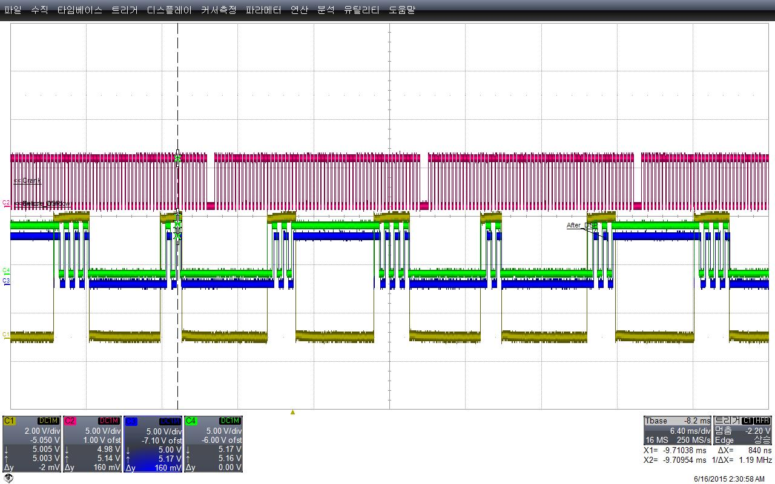
SW Operation
CRANK
KNOCK_WINDOW
DATA_IN
AFTER_DSP

Slide 4
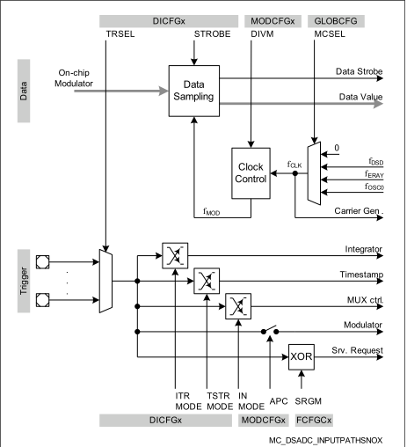
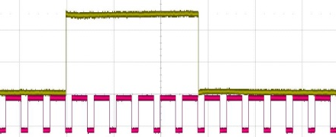
SW Design detail concept-Data generation
DSADC is triggered, when Knock window is high.
Interrupt is generated, when each data is created.

Slide 5
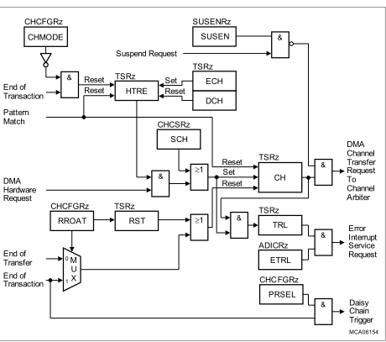
SW Detail design concept-Trigger connection
DMA
DSADC
DSADC IR is connected to DMA Hardware request.

Slide 6
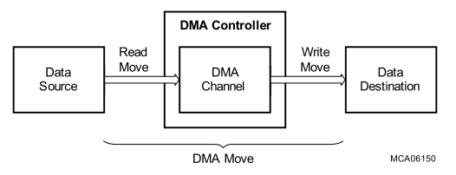
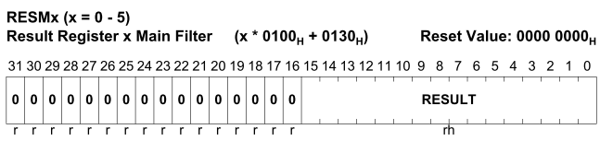
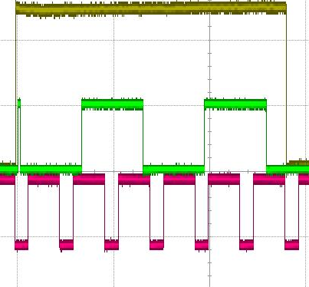
SW Detail design concept-Double buffering
DSADC
These are buffer switch point.
CRANK signal
KNOCK_WINDOW
Buffer switch

Slide 7
SW Detail design concept-Double buffering
Considering Group Delay, 20 data is ignored.
CRANK signal
KNOCK_WINDOW
DMA Buffer switch

Slide 8
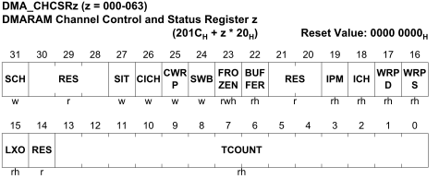
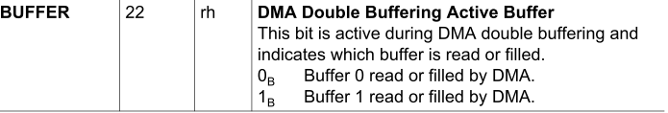
SW Detail design concept-Double buffering
If user want to check BUFFER NUM in ISR to know what is filled with data, Return value is current working BUFFER NUM. So user should use
Opposite NUM BUFFER.
But if DMA is not working, User can use Buffer num directly.
CRANK
KNOCK_WINDOW
DATA_IN
Using DMA, Generated DATA at DSADC is moved to destination.
At here , DMA use Double buffering functionality.
DMA destination is automatically switched from one to the other when data is filled fully.

Slide 9
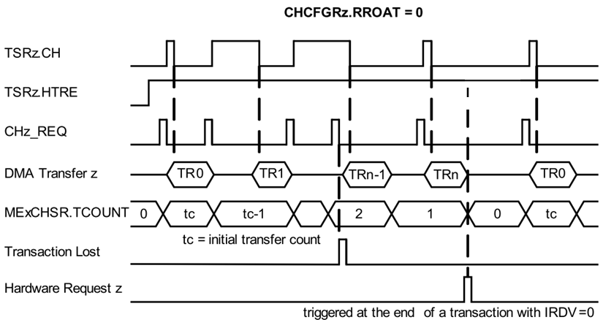
SW Detail design concept-Data transfer
RROAT = 0;
TSRz.CH is reset after each transfer. A transfer request is required for each transfer
CHMODE = 1;
Continuous Mode operation is selected for DMA channel z.
After a transaction, bit TSRz.HTRE remains set

Slide 10
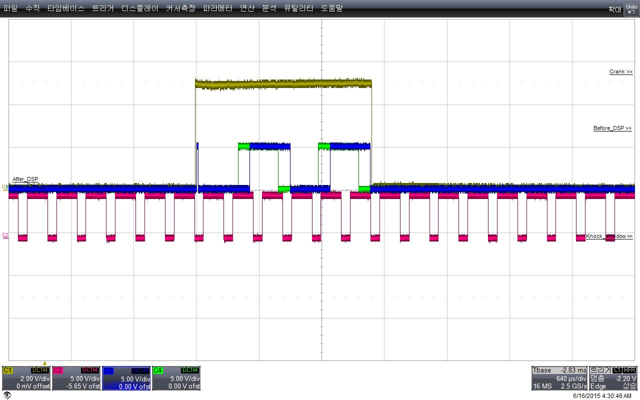

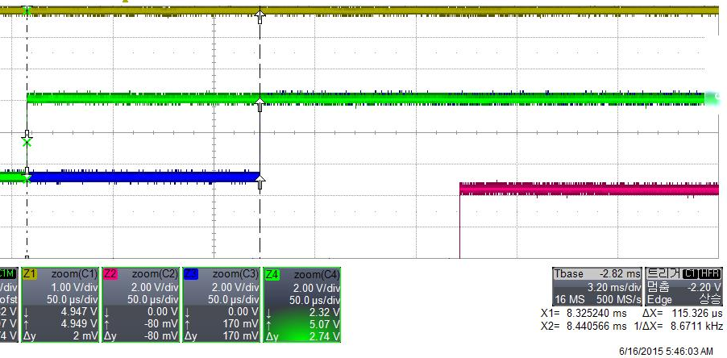
SW Detail design concept-Signal processing
DSP lib Ifx_firRealQ15a is called, when buffer is full
dB
Band pass filter
115.326us(128Data)
freq.[KHz]
CRANK
KNOCK_WINDOW
DMA Buffer switch
AFTER_DSP

Slide 11
SW Detail design concept-Ignore data
Considering Group Delay, 10 data is ignored.

Slide 12
SW Detail design concept-ISR
Knocheck_Window_ISR is called, when window open or close
DMA_FULL_ISR is called, when buffer is full

Slide 13
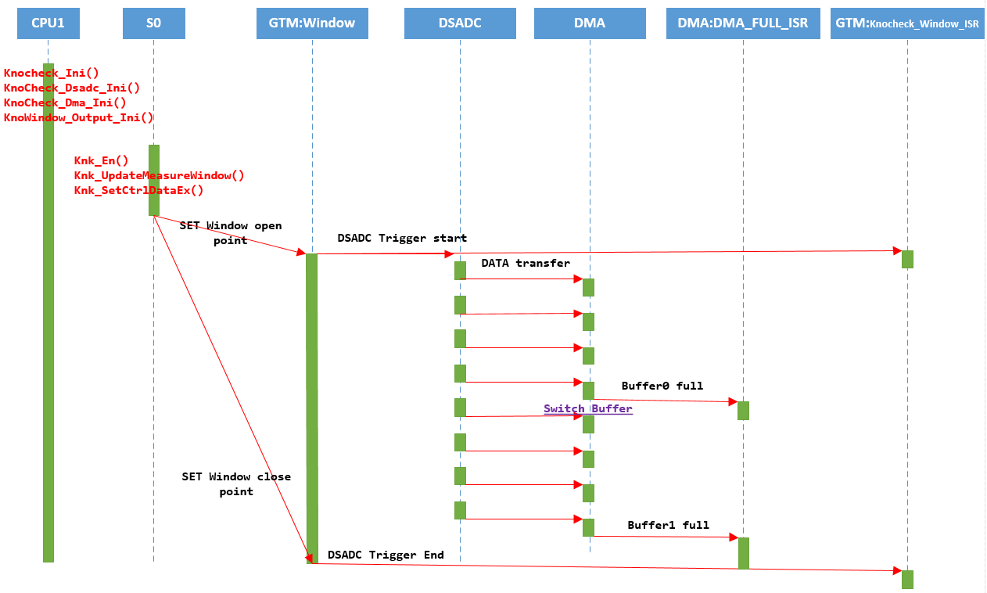
Dynamic view

Slide 14
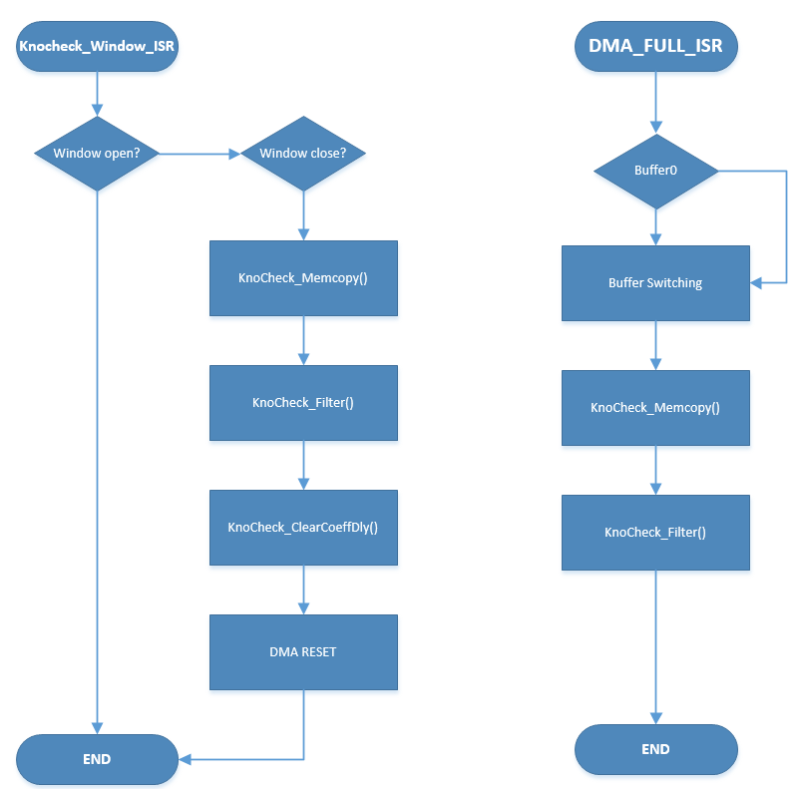
ISR Flowchart

Slide 15
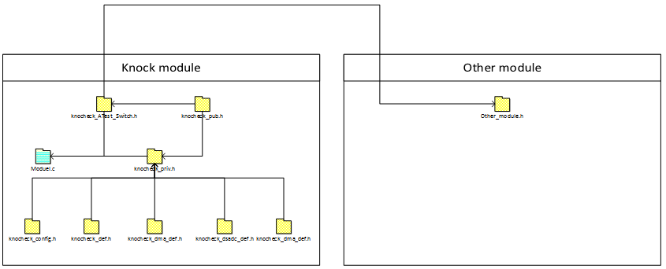
Module Interface

Slide 16
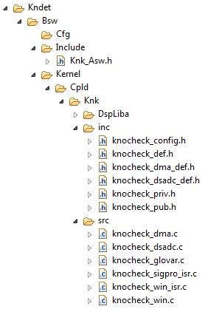
Folder structure
knocheck_config.h: All system dependent defines are in here.
knocheck_def.h: General knock dependent defines, structures, enums are in here.
knocheck_dma_def.h: DMA dependent defines, structures, enums are in here.
knocheck_dsadc_def.h: DSADCdependent defines, structures, enums are in here.
knocheck_priv.h: Knock module extern, includes are in here.
knocheck_pub.h: Interface function and values are in here. Other modules are can access this module only through this header file.
knocheck_dma.c: DMA Initialization functionality is in here
knocheck_dsadc.c: DSADC Initialization functionality is in here
knocheck_glovar.c: All global values are in here
knocheck_sigpro_isr.c: IR is occurred, when destination buffer is full. Accumulate datas are filter calculated at here.
knocheck_win_isr.c: IR is occurred, when window open or close. Accumulate datas are filter calculated at here.
knocheck_win.c: Knock Window Initialization functionality is in here

Slide 17

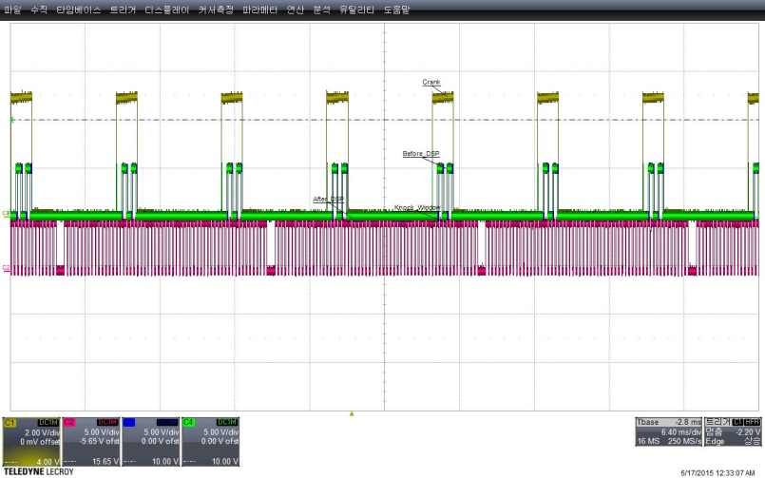
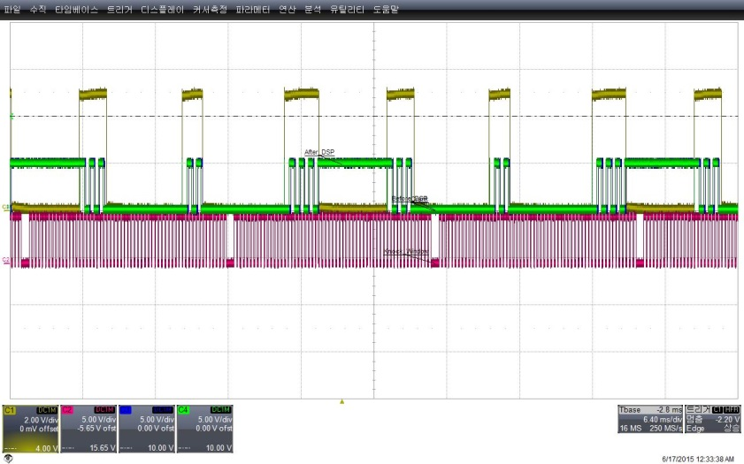
Test Result-Window length change

Slide 18
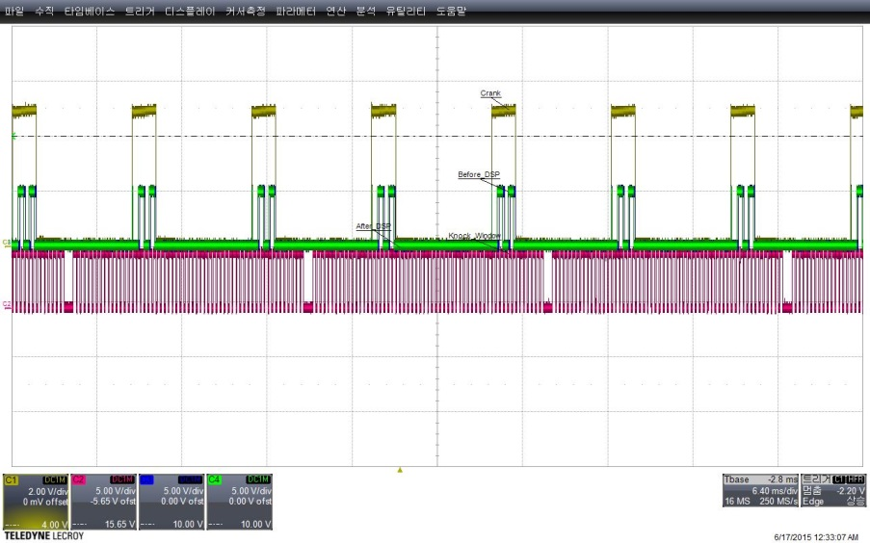
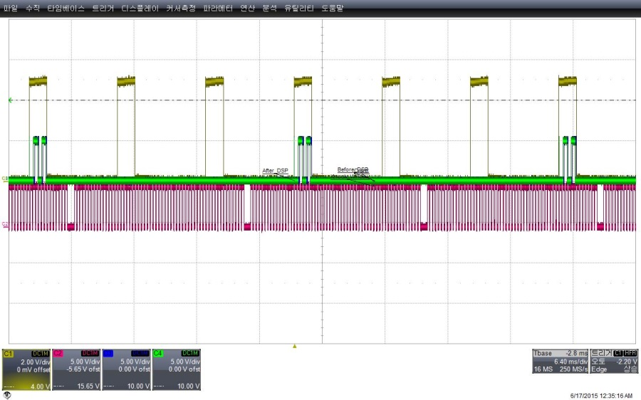
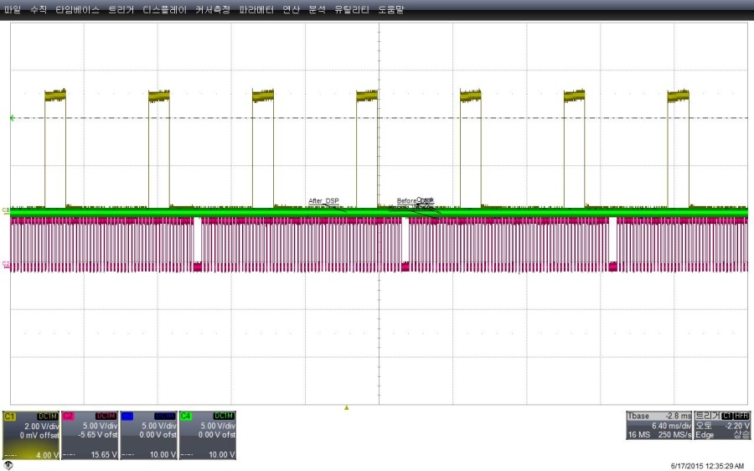
Test Result-Module Enable

Slide 19
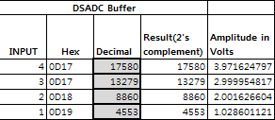
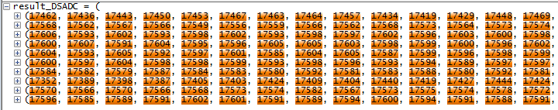
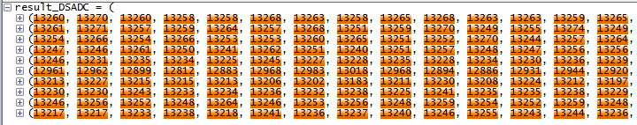
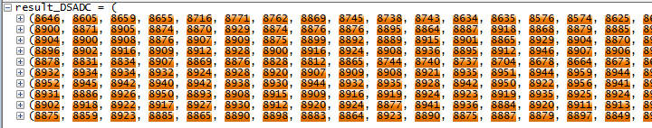
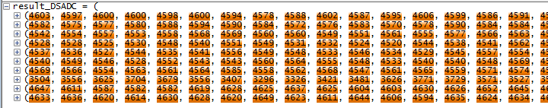
Test Result-DSADC measurement
Calculated Value
Measurement Value

Slide 20
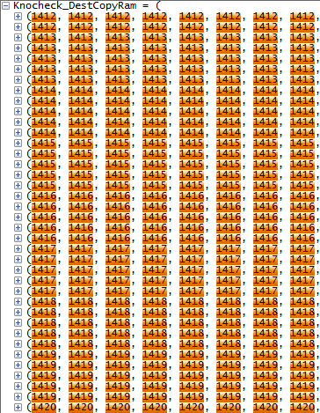
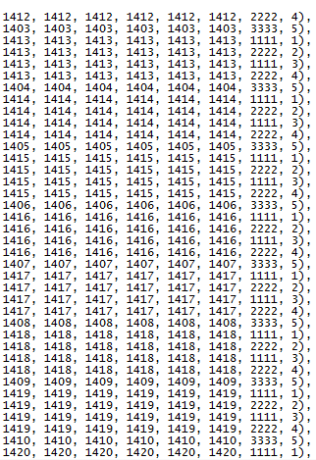
Test Result-Data input validation
Input data order
1111:buffer 0
2222:buffer 1
3333:Window close buffer 0
4444:Window close buffer 1

Slide 21
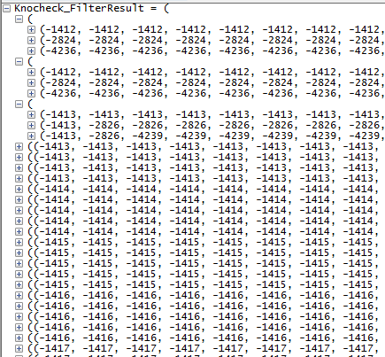

Test Result-Signal processing

Slide 22
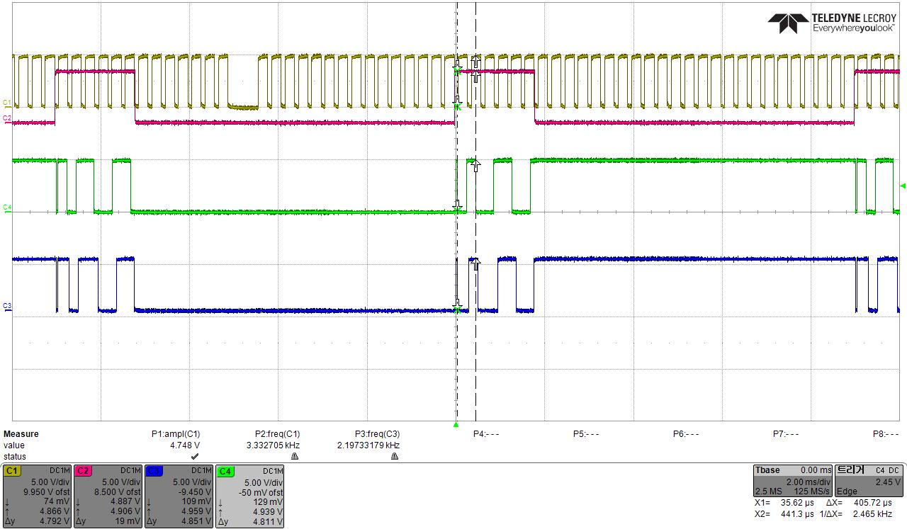
Test Result-Not integrate data
Receive the 128 data, but these data not participate to integration calculation.

Slide 23
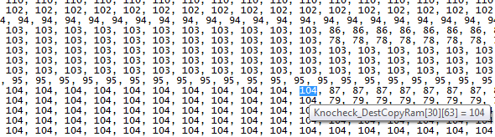
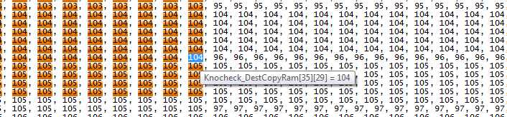
Test Result-Not integrate data
Data input check test pass

Slide 24
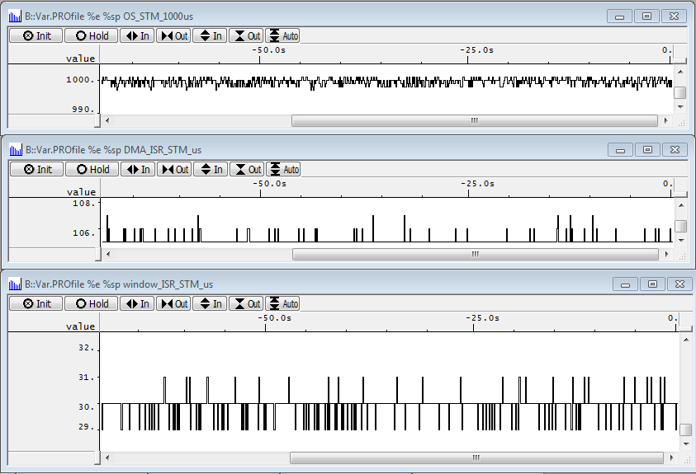
Test Result-Execution time test
1ms OS Task 수행주기
128Data 입력에 대한 FIR 처리
31~40 Data 입력에 대한 FIR 처리

Slide 25
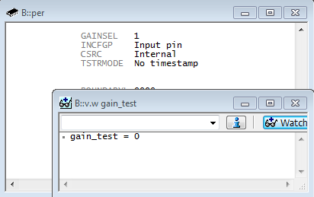
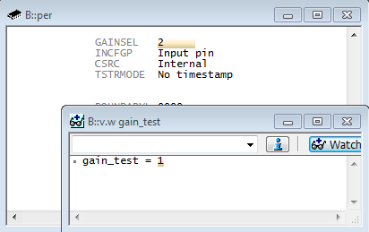
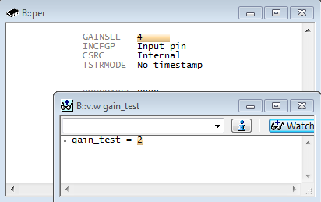


Test Result-Gain test
INCFGP, INCFGN, GAINSEL, INSEL, INMODE, INMAC 접근관리 비트인 INCWC가 미반영 되어 버그 발생.
아래와 같이 SW 업데이트

Slide 26
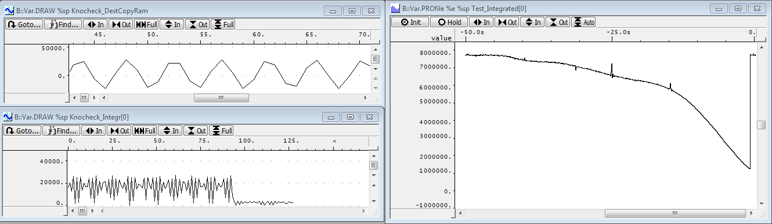
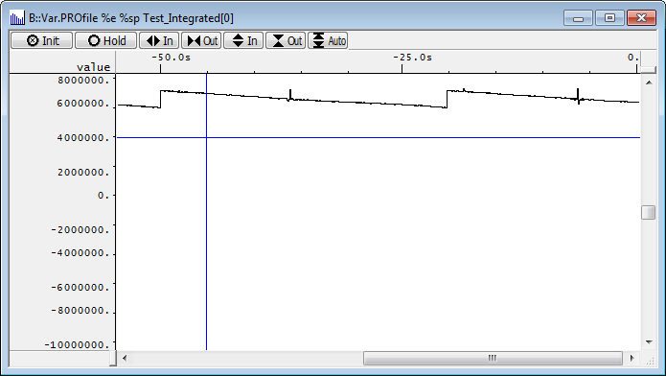
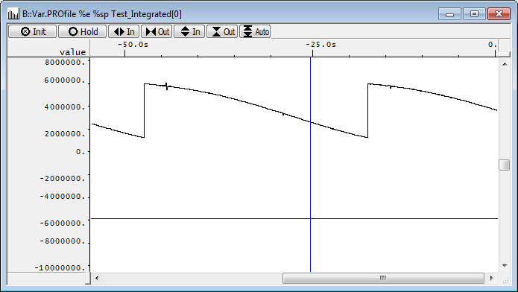
Test Result-Frequency test
DMA data
.0~140Khz sweep for 50s
After Filterdata
.60~100Khz sweep for 30s
.40~140Khz sweep for 30s

Slide 27
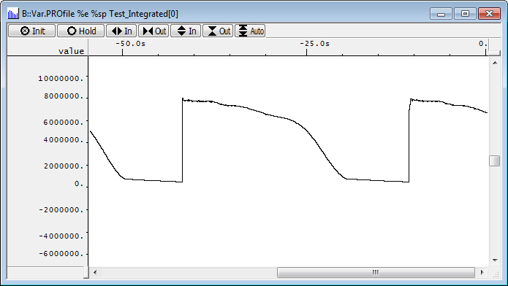
Test Result-Frequency test
.10~200Khz sweep for 30s

Slide 28
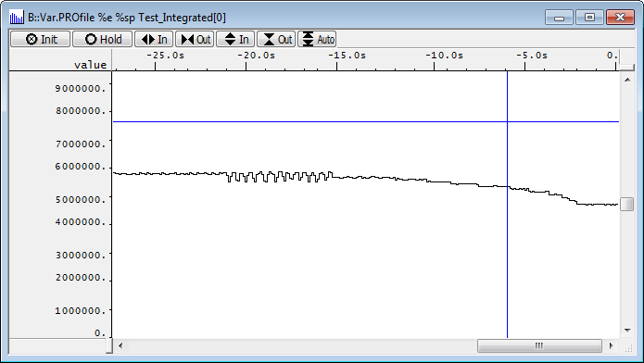
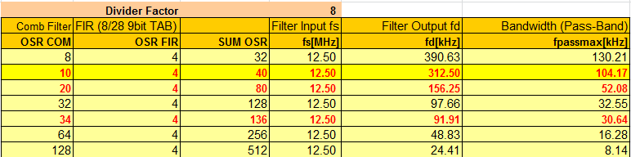
Test Result-Frequency test
.104Khz 에서 Integration 값이 급격하게 변화면서 1KHz 단위로 값이 급격하게 변하기 시작

Slide 29

TDC
TDC
Over advanced timing
Proper timing
Retarded timing
TDC: Top dead center

Slide 30
TDC
Over advanced Ignition timing
Cylinder pressure
Knock
Proper ignition timing
Retarded ignition timing
No ignition
Crank Angle

Slide 31
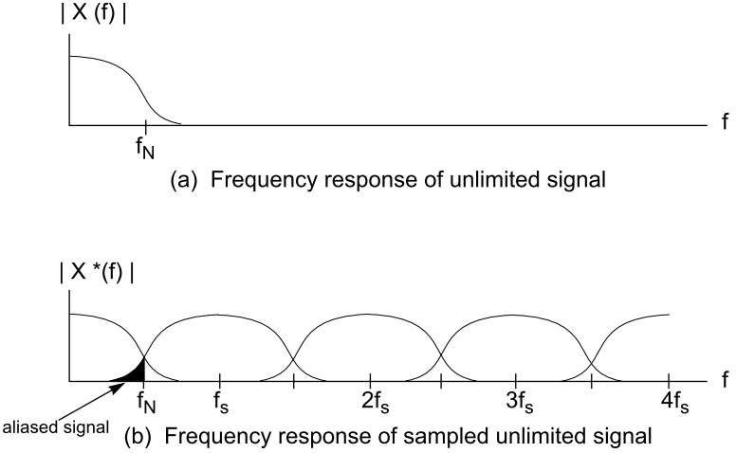

Slide 32
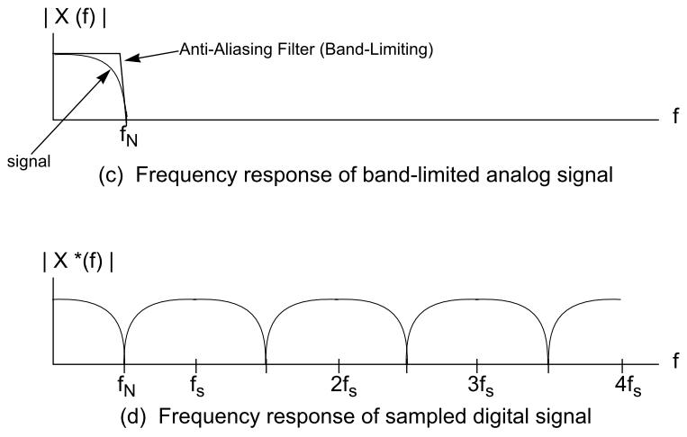

Slide 33


Slide 34


ATOM
DSADC
DMA
FIR filter

Slide 35

DMA

Slide 36

FIR filter
0KHz
30KHz
104KHz

Slide 37


.0~200Khz sweep for 4s
12Khz
13Khz
14Khz
15Khz

Slide 38

SW Design detail concept-Data generation
DSADC

Slide 39
Analog signal
Digital signal
Group delay
Data come in from here

Slide 40





